Slide 1
Start bulinding 3D models in Studio
Revolution Robotics Foundation

Slide 2
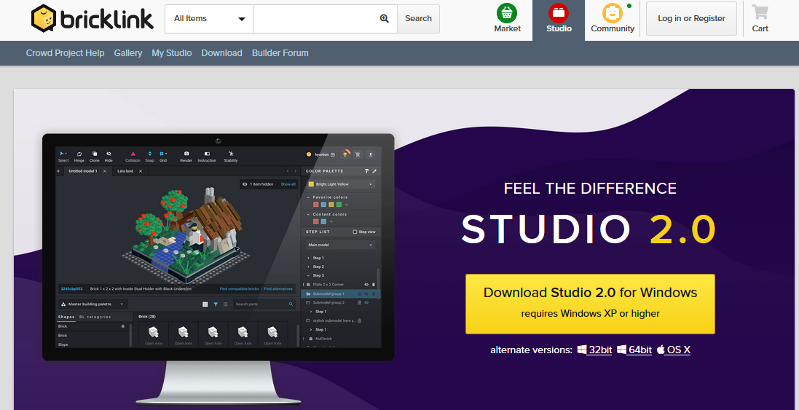
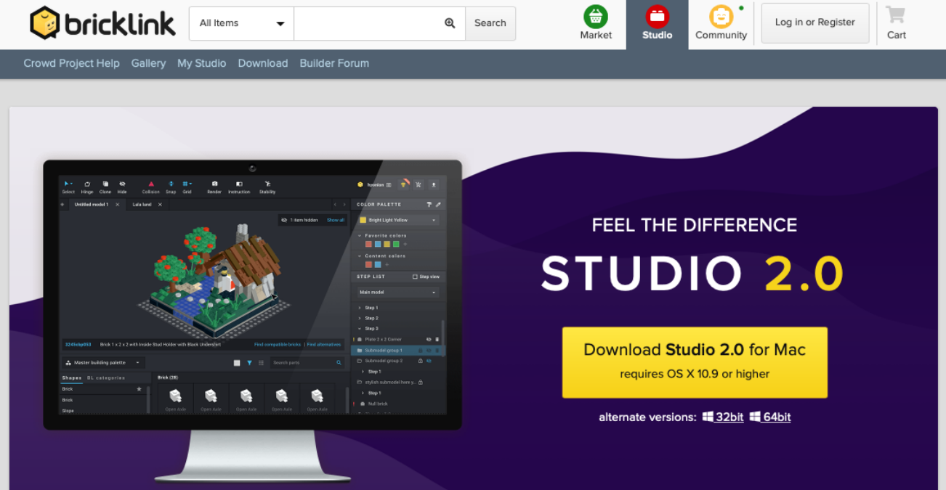
1. Download Studio for Windows or Mac
https://studio.bricklink.com/v2/build/studio.page

Slide 3
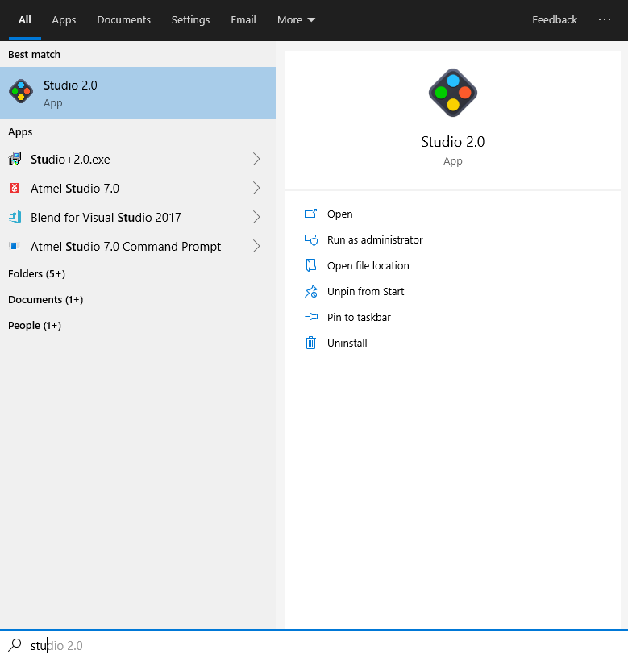
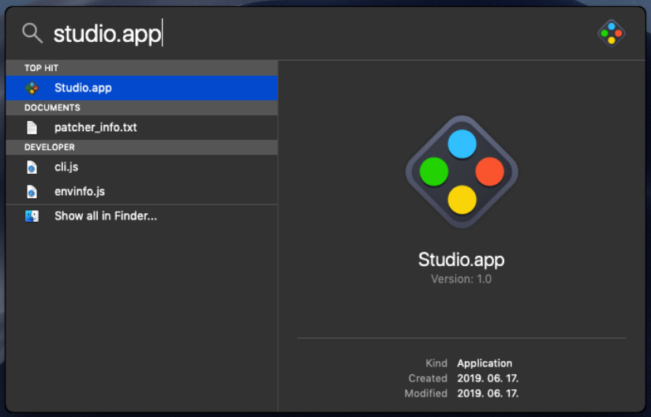
2. Start Studio app for the first time to initialize folders
At the very first start the app might crash, don’t worry, it’s normal. Just start it again.
After the first successful start just close Studio

Slide 4
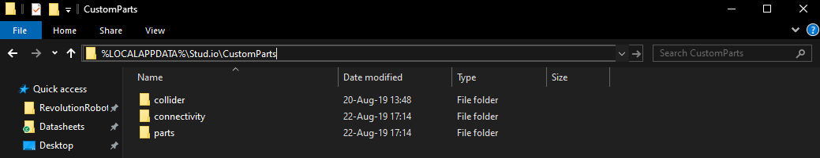
3. Open the “Custom parts” location - Windows
On Windows 10 open this folder: “%LOCALAPPDATA%\Stud.io\CustomParts”
Delete every existing folder here, we don’t want to mix our parts with some custom Lego flowers…

Slide 5
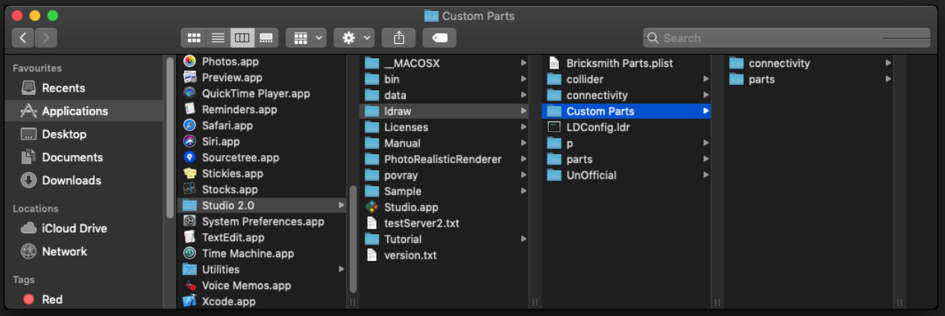
3. Open the “Custom parts” location - Mac
Open this folder: “Applications/Studio 2.0/ldraw/Custom Parts”
Delete every existing folder here, we don’t want to mix our parts with some custom Lego flowers…

Slide 6
4. Download our models
You can download it from Google drive: https://drive.google.com/file/d/1EtdtKqdZHvAQjKXpG3DQAwoRQfEWCn5S/view?usp=sharing
Or from our Structural parts repository on GitHub: https://github.com/RevolutionRobotics/StructuralParts/blob/master/LDraw%20models/LDraw%20models.zip

Slide 7
5. Copy the files to “Custom parts” folder
Copy “parts” and “connectivity” folders to:
Windows: “%LOCALAPPDATA%\Stud.io\CustomParts”
Or
Mac: “Applications/Studio 2.0/ldraw/Custom Parts”
Mac: “/Users/[your_username]/.local/share/Stud.io/CustomParts/”

Slide 8
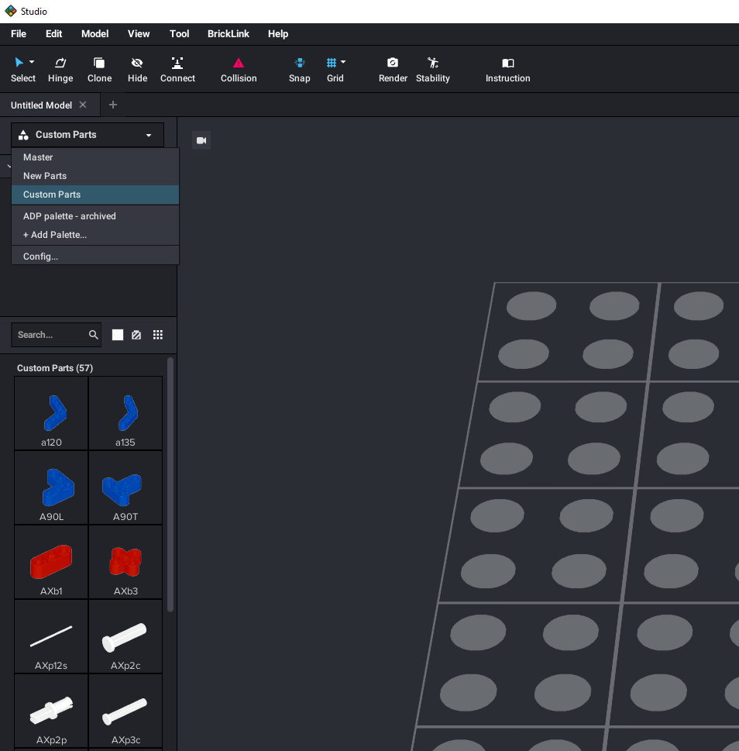
6. Open Studio and select custom parts
Select custom parts
Now you should be able to see our parts in the list

Slide 9
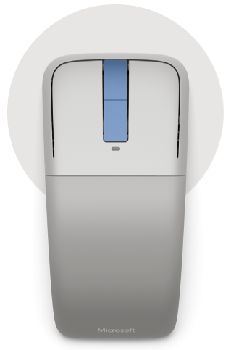
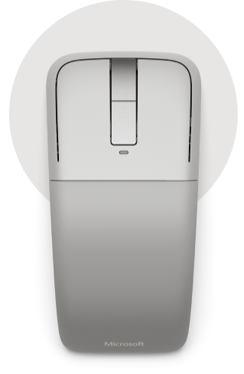
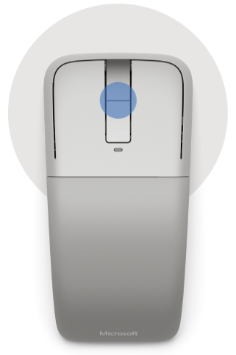
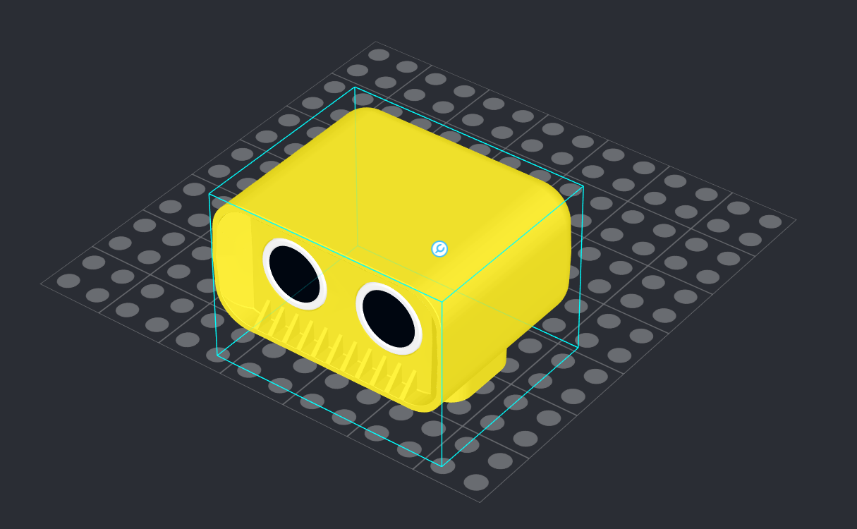
7. Using Studio - basics
You can zoom in and out with mouse scroll wheel
You can rotate the 3D build space with right mouse button pressed
You can pan the 3D build space with middle mouse button pressed

Slide 10
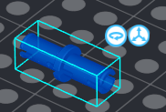
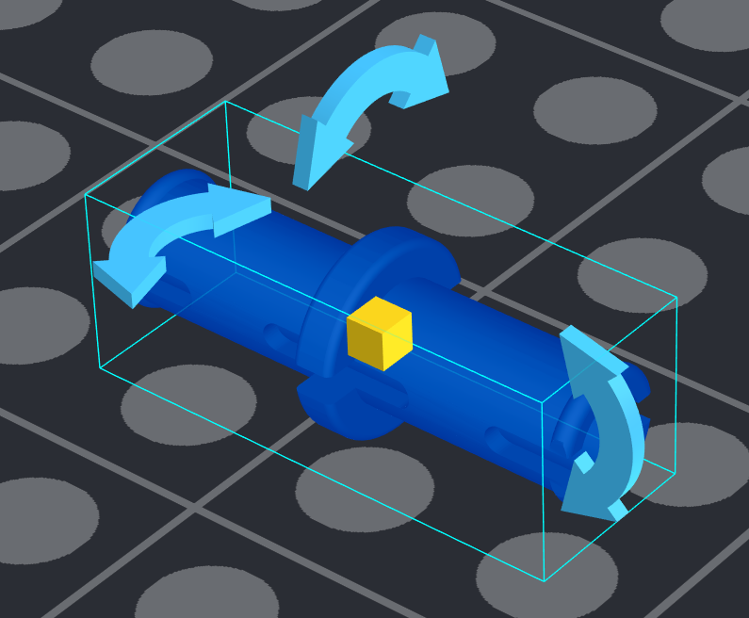
7. Using studio - parts
Drag and drop parts from the list
Rotate to the desired orientation
Drag and drop to the desired place, it automatically snaps to the connections
Click there!

Slide 11
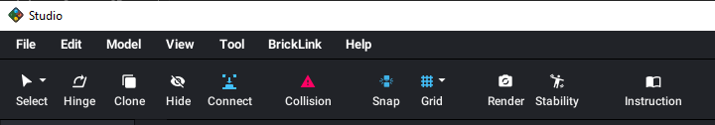
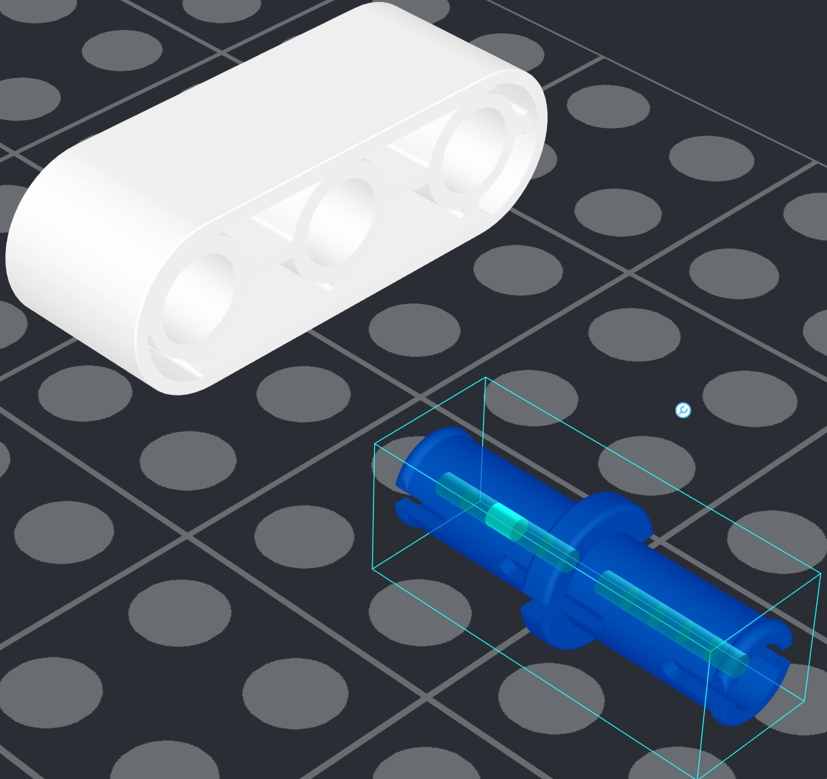
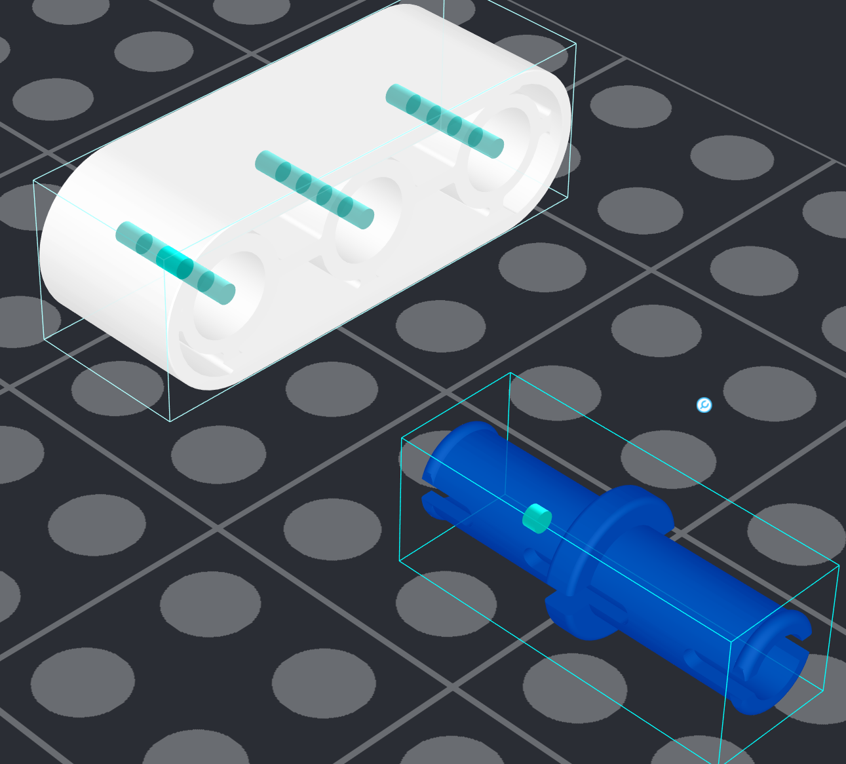
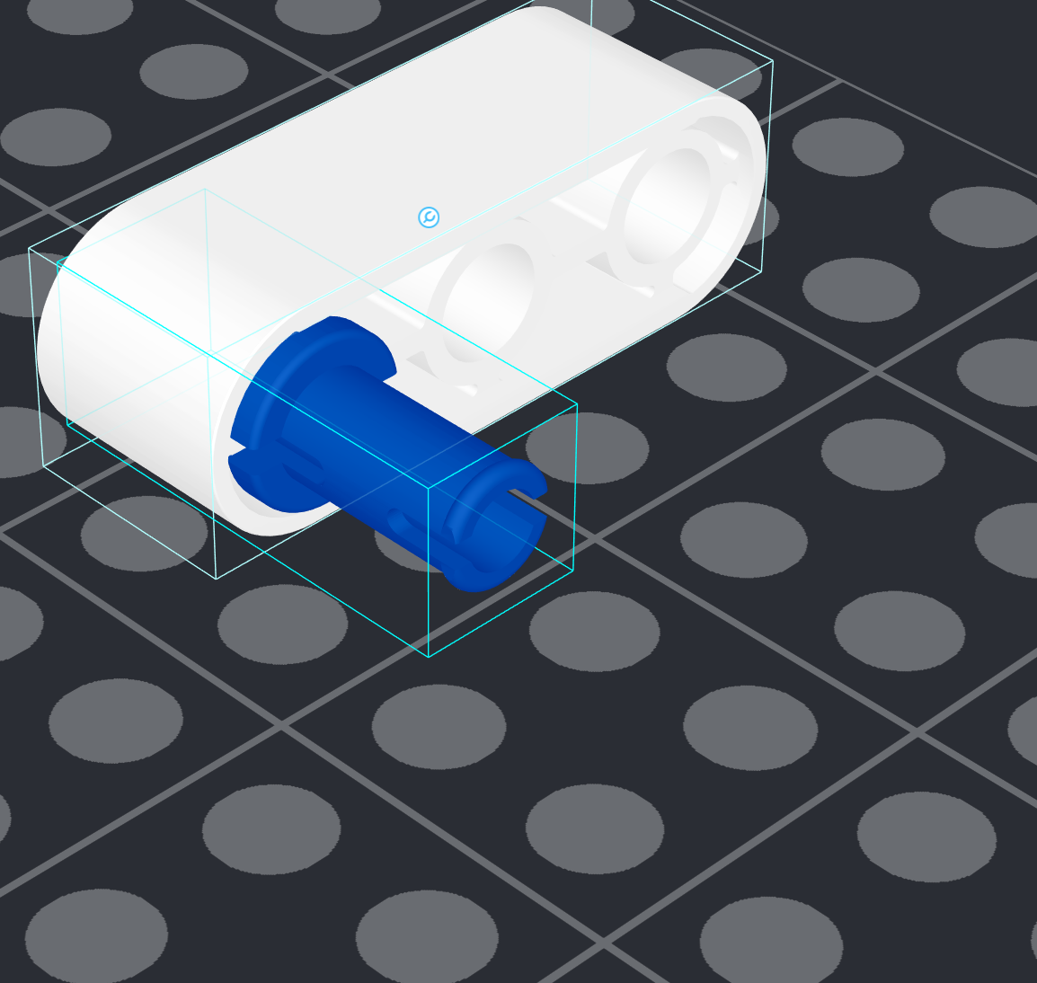
7. Using Studio - Connectivity
If snapping doesn’t work well, you can use connectivity tool.
First select WHAT you want to connect
Second select WHERE you want to connect

Slide 12
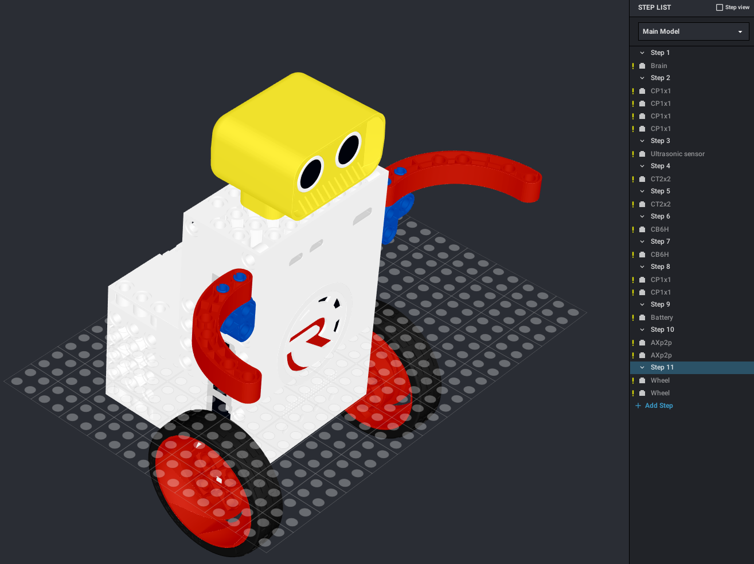
8. Building steps
You can setup the building steps on the right panel
Simply drag and drop parts to a step

Slide 13
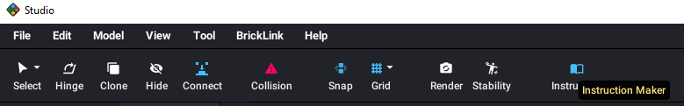
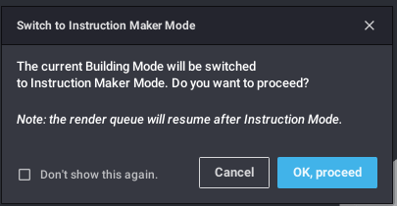

9. Generating build instructions
Open instruction maker
Go to the Instruction maker screen
If you already set up the building steps, you can go to page designer

Slide 14
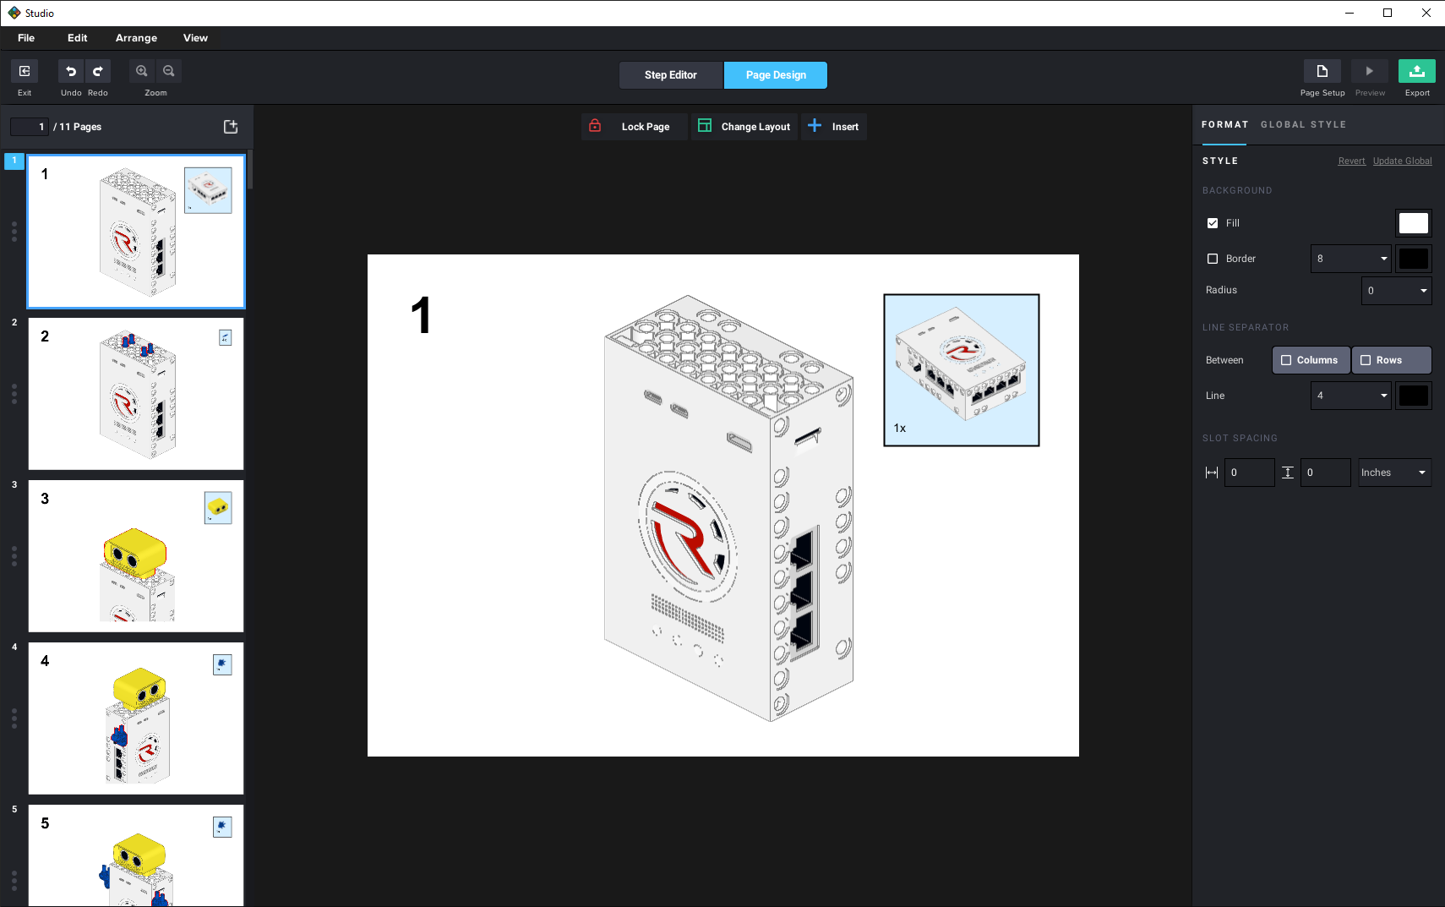
9. Generating build instructions
You can customize the canvas size, highlight, camera angles, part pictures size and many other settings.
You can export to pdf or png

Slide 15
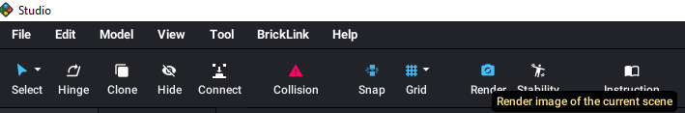
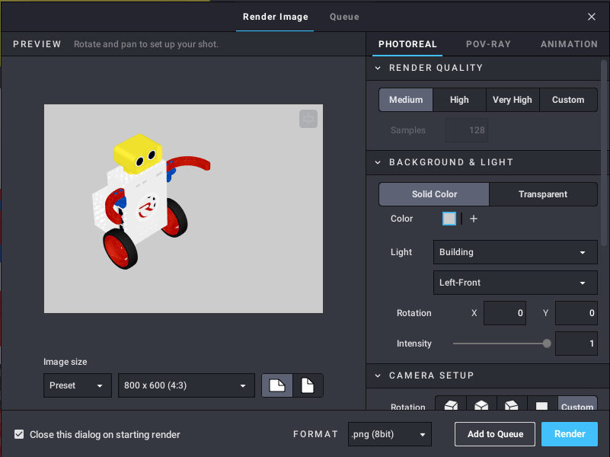
10. Rendering
Open rendering tool
Adjust settings
Press “Render”
Wait a few minutes :-)

Slide 16
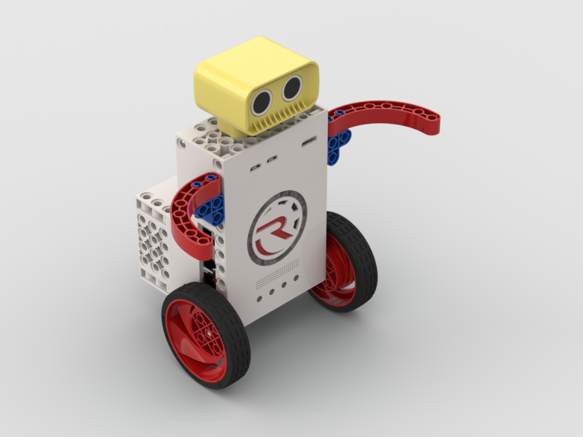
10. Rendering

Slide 17
11. Example projects
https://drive.google.com/file/d/1EwhQET_VpJGDdJGbk0Xr25MligYWScqh/view?usp=sharing

